Slide 1
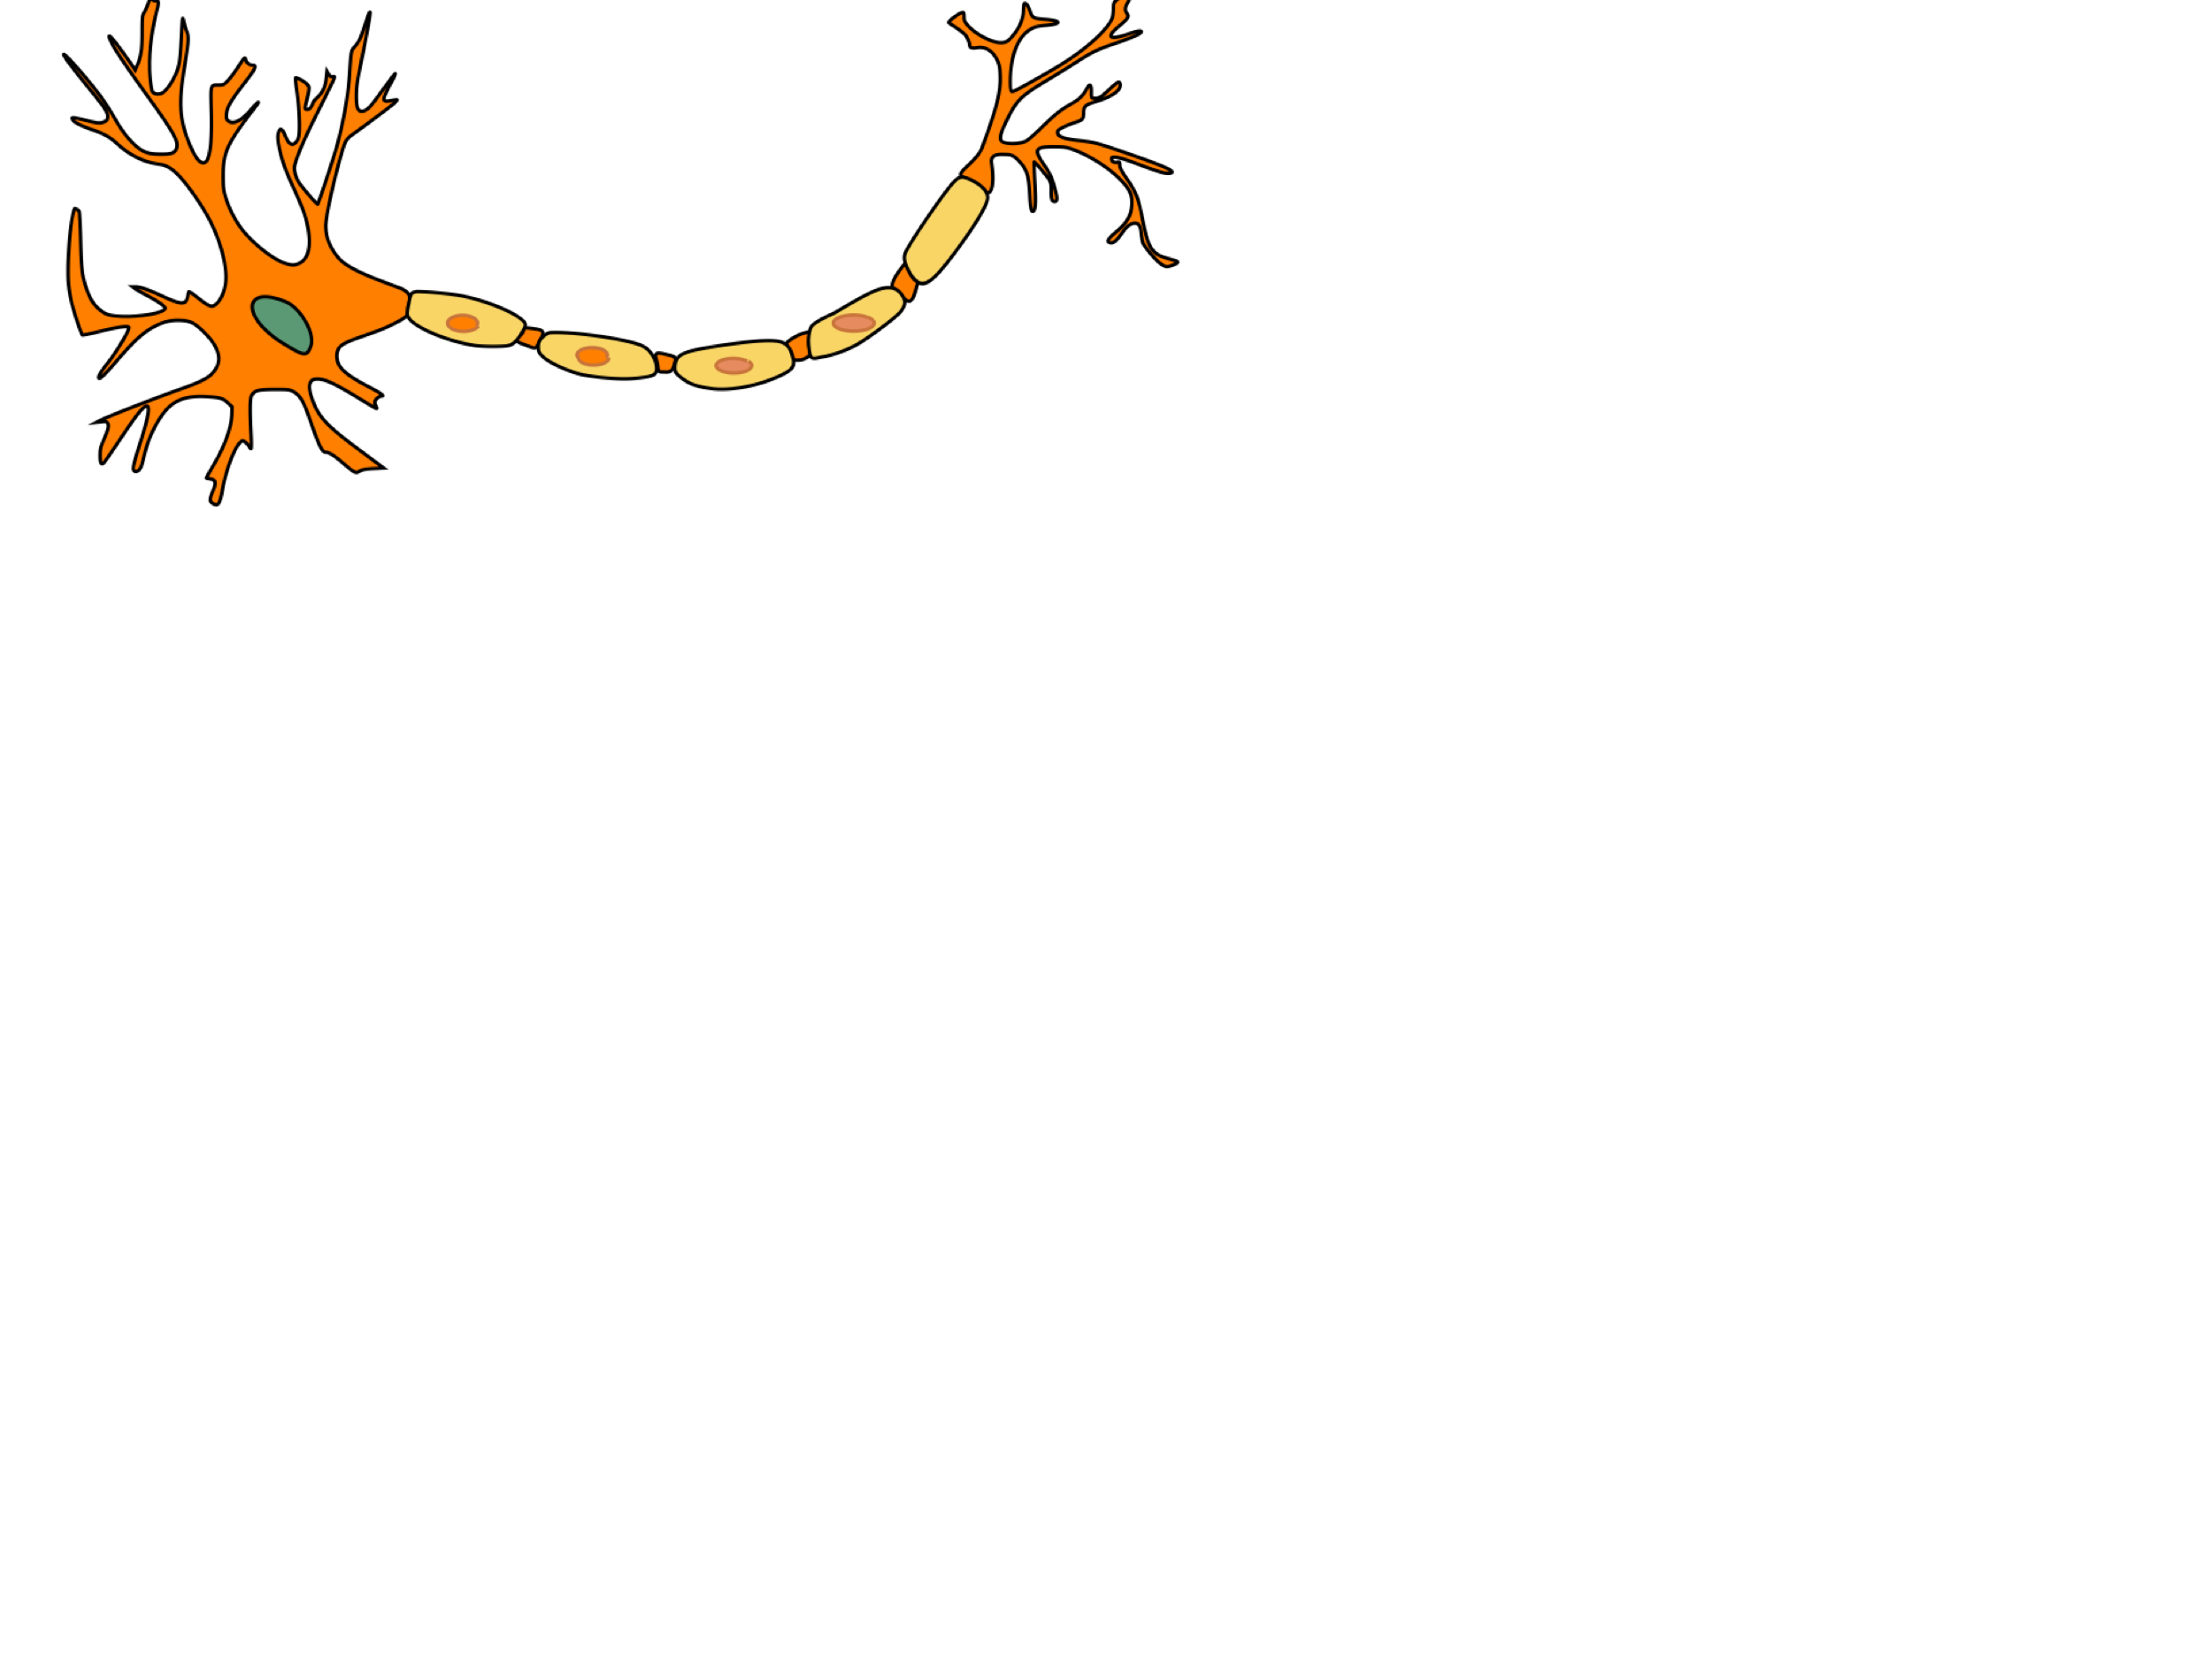
Project Logic Brain : a Binary Neural Networks acceleration
Presented by:
Alexandre Riviello
Nathan Heraief
Mohammad Hossein Askari

Slide 2
1. Introduction
Context
The basic audio recognition Tensorflow models are based off a paper written by Sainath et al. in 2015.
A group of researchers at the University of Waterloo decided to reimplement these models in PyTorch to be consistent with the other researchers in their department.
Their implementation includes the preprocessing of the audio inputs and the CNN models that are found in the Tensorflow library.
https://www.isca-speech.org/archive/interspeech_2015/papers/i15_1478.pdf
https://arxiv.org/pdf/1710.06554.pdf

Slide 3
2. Presentation Plan
Structure
Project overview
Memory management
Neural core
Controller unit
Improvements

Slide 4
3. Project Overview
1. Description of the preprocessing of the audio inputs

Slide 5
4. Memory Management
1. Description of our Memory handle process

Slide 6
4. Memory Management
2. Simulation, and results

Slide 7
5. Neural core
1. Description of the preprocessing of the audio inputs

Slide 8
6. Controller Unit
2. Explanation of the Python code for the preprocessing (part 3)

Slide 9
5. Improvements
2. Explanation of the Python code for the preprocessing (part 4)

Slide 10
6. Conclusion
Summary
Preprocessing of data for voice recognition using CNNs
Example of a model using PyTorch

Slide 11
7. References
[1] Tang, R., & Lin, J. (2017). Honk: A PyTorch reimplementation of convolutional neural networks for keyword spotting. arXiv preprint arXiv:1710.06554.
[2] Sainath, T. N., & Parada, C. (2015). Convolutional neural networks for small-footprint keyword spotting. In Sixteenth Annual Conference of the International Speech Communication Association.

